Slide 1
CS 4530: Fundamentals of Software Engineering Module 11.1: Interaction-Level Design Patterns
Adeel Bhutta, Rob Simmons, and Mitch Wand
Khoury College of Computer Sciences
© 2026 Released under the CC BY-SA license
Notes:
This is lesson 6, the Interaction Scale.

Slide 2
Learning Goals for this Lesson
At the end of this lesson you should be able to:
Explain how patterns capture common solutions and tradeoffs for recurring problems.
Explain and give an example of each of the following:
The Demand-Pull pattern
The Data-Push (aka Listener or Observer) pattern
The Singleton pattern
Do the same for other mini-patterns
Dependency Injection
The Delegate or Callback pattern
The first-time-through switch
Notes:
<read slide>

Slide 3




A Different Perspective On The Three Scales of Design
PROGRAMS
The Structural Scale
key questions: what are the pieces? how do they fit together to form a coherent whole?
The Interaction Scale
key questions: how do the pieces interact? how are they related?
The Code Scale
key question: how can I make the actual code easy to test, understand, and modify?
PLANNING
ORGANIZING
implementing
Notes:
In the big picture of the course, we’ve seen this picture before we motivated code-level design principles. The main topic of that lecture was writing your code to minimize the cognitive load of understanding programs.
Today, we’re going to move up and talk about the interaction scale.

Slide 4
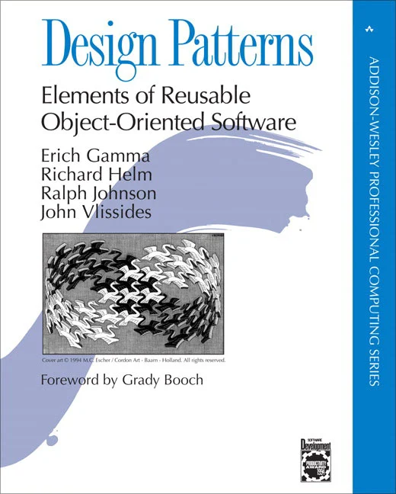
Design at the Interaction Level corresponds to “OOD Design Patterns”
Four people in the 90’s wrote a book that lists a lot of patterns.
But this is not the be-all and end-all of patterns
We’ll see patterns at lots of different levels.
Notes:
This part of today’s lecture is a bit of a review; most of these are things you probably learned in OOD, and our goal is to connect them to what we’ve discussed in the class.

Slide 5
Pull and Push patterns
Lots of times we need to get some data from one place in our program to another.
There are two basic ways of accomplishing this, which we call "pull" and "push"
In each situation we have two objects, which we call the "producer" and the "consumer"
But there many variations. Let's look at a few of them.

Slide 6
Let's start with a very simple example
We have a clock, which is updated every so often with the current time
right now, we don't care how that happens
We have several client modules that need to know the current time.
The clock is the producer
The client modules are the consumers

Slide 7
Example: Interface For a Simple Clock
src/pullingClock/IPullingClock.ts
export interface IPullingClock {
/** sets the time to 0 */
reset(): void;
/** increments the time */
tick(): void;
/** returns current time */
currentTime(): number;
}
Notes:
Let’s take a look at a concrete example. Here is an interface for a simple clock.
It has three methods: reset, tick, and currentTime.
In our examples, we use the tick() method as in input to increment the time. In a real example, this might be done with a setInterval (as we did in the React Hooks lecture)
Note that the interface includes a description of what each method is supposed to do. This is part of the "make your Data Mean Something" principle we talked about in the lecture about writing Maintainable Code.

Slide 8
Example: Implementing a Simple Clock
src/pullingClock/simpleClockUsingPull.ts
export interface IPullingClock {
/** sets the time to 0 */
reset(): void;
/** increments the time */
tick(): void;
/** returns current time */
currentTime(): number;
}
export class SimpleClock implements IPullingClock {
private _time = 0;
reset() {
this._time = 0;
}
tick() {
this._time += 1;
}
currentTime() {
return this._time;
}
}

Slide 9
Example: Using a Simple Clock
src/pullingClock/simpleClockUsingPull.ts
export interface IPullingClock {
/** sets the time to 0 */
reset(): void;
/** increments the time */
tick(): void;
/** returns current time */
currentTime(): number;
}
export class ClockClient {
private _theClock: IPullingClock;
constructor(theClock: IPullingClock) {
this._theClock = theClock;
}
get time(): number {
return this._theClock.currentTime();
}
}
Notes:
Here's a very simple client that uses a clock.
The constructor says “theclock:IPullingClock”, because this client depends only on the fact that ‘theClock’ obeys the Interface. We’re not requiring a specific clock implementation, we’re accepting anything that respects the interface.
In OOD Pattern terminology, this is called "Dependency Injection".

Slide 10
Testing the simple clock
src/pullingClock/simpleClockUsingPull.test.ts
import { SimpleClock, ClockClient } from "./simpleClockUsingPull.ts";
test("test of SimpleClock", () => {
const clock1 = new SimpleClock();
expect(clock1.currentTime()).toBe(0);
clock1.tick();
clock1.tick();
expect(clock1.currentTime()).toBe(2);
clock1.reset();
expect(clock1.currentTime()).toBe(0);
});
Notes:
This illustrates how we use tick() and reset() to control the clock. (This would be a lot harder if our clock ran autonomously.)
Of course there are more tests in the file, go look at it.

Slide 11
We call this the "demand-pull" pattern
because the when the client needs some data, it pulls the data it needs from the server.
Alternative names: you could call the SimpleClock the “producer” and call the ClockClient the “consumer”

Slide 12
But there's a potential problem here.
What if the clock ticks once per second, but there are dozens of clients, each asking for the time every 10 msec?
Our clock might be overwhelmed by polling behavior
Can we do better for the situation where the clock updates rarely, but the clients need the values often?

Slide 13
The 'data-push' pattern
Instead, let's arrange it so that the server pushes the data to the consumer only when it changes
That will make it the responsibility of the clock to keep track of the clients it needs to notify.
We can do that in several ways; let's use one that matches one you've seen before.

Slide 14
Interface For a Clock Using the Push Pattern
src/pushingClock/IPushingClock.ts
export type IPushingClockListener = (time: number) => void;
export interface IPushingClock {
/** increments the time, notifies consumers of the new time */
tick():void
/** resets the time to 0 */
reset():void
/** returns the current time */
currentTime(): number
/** adds a new consumer */
addListener(listener: IPushingClockListener): void
}
"delegate" or "callback"
Notes:
Here is an interface for a clock using the Push pattern.
We represent the listener as a function to be called whenever the current time is updated.
<Go through methods
The description of `addListener` indicates an expectation that a clock may have more than one consumer or listener.
A more complete description might mention that the clock can handle some maximum number of consumers, but we don’t care about that here.
We could also have a `removeListener` method.
We also have different choices for the type IPushingClockListener-- we'll talk about that in a few minutes.

Slide 15
Implementing a Clock with the Push Pattern
src/pushingClock/pushingClock.ts
export class PushingClock implements IPushingClock {
private _time = 0;
private _observers: IPushingClockListener[] = [];
private _notifyAll() {
this._observers.forEach((observer) => observer(this._time));
}
/** resets the time to 0 */
reset() { this._time = 0; this._notifyAll(); }
/** increments the time, notifies consumers of the new time */
tick() { this._time += 1; this._notifyAll(); }
/** returns the current time */
currentTime() { return this._time; }
/** adds a new consumer */
addListener(observer: IPushingClockListener) {
this._observers.push(observer);
}
}
Notes:
Clients of the pulling clock don’t hold on to any references to the clock — so the clock has to hold on to references to its clients. Whenever the time changes, the clock fulfills its obligation to contact all its clients.

Slide 16
Using a Pushing Clock
src/pushingClock/pushingClockClients.ts
export type IPushingClockListener =
(time: number) => void;
export interface IPushingClock {
/** as before */
tick():void
reset():void
/** adds a new consumer */
addListener(listener: IPushing…
}
export class PushingClockClient {
private _time: number;
constructor(theClock: IPushingClock) {
this._time = theClock.currentTime();
theClock.addListener((time) => {
this._time = time;
});
}
get time(): number {
return this._time;
}
}
Notes:
The PushingClockClient has almost exactly the same interface as the PullingClock — the only difference constructor takes an IPushingClock instead of an IPullingClock.
But the implementation is quite different — the pulling clock client had to hang on to the reference to the clock.
The constructor just hands the clock a function, which gives the pushing clock instructions on how to contact the client. It also pulls the time exactly once: in the constructor.
After the constructor returns, the pushing clock client doesn’t have any way of contacting the pushing clock again.

Slide 17
A More Conventional Design of a Pushing Clock
export interface INotifyingClock {
/** as before */
tick(): void; reset(): void;
currentTime(): number;
/** adds a new consumer */
addClient(client: INotifyingClockClient): void;
}
export interface INotifyingClockClient {
/** called when the clock ticks, with the new time */
onClockTick(time: number): void;
}
Notes:
Here, the clock represents each consumer as an entire object, and the consumer expects to be called with 'onClockTick' at each tick of the clock. You may find this representation familiar from the OOD/Java world, but in the WebAPI world, the callback implementation is much more common.

Slide 18
A More Conventional Client
export class NotifyingClockClient implements INotifyingClockClient {
private _time: number;
constructor(theClock: INotifyingClock) {
this._time = theClock.currentTime();
theClock.addClient(this)
}
onClockTick(time: number) {
this._time = time;
}
currentTime(): number {
return this._time;
}
}
Notes:
The conventional client hands itself to the clock as a representation, and the clock pushes the time to the client by calling the client's onClockTick method.
This more conventional design, using only classes and methods, is likely what you were taught in OOD. But nowadays we have other options, like passing procedures!

Slide 19
This these are all instances of the Listener or Observer Pattern
Also called "publish-subscribe pattern” (or “pub/sub”)
Some people make fine-grained distinctions between pub/sub and observer/observable; we won’t do that here.
The object being observed (the “subject”) keeps a list of the objects who need to be notified when something changes.
subject = producer = publisher
When a new object (i.e., the “consumer”) wants to be notified when the subject changes, it registers with ("subscribes to") the subject/producer/publisher
observer = consumer = subscriber = listener
Notes:
In any case,
<read slide>
The second bullet should really say "a list of representations of the objects who need to be notified…". In the conventional implementation these are the objects themselves; in our first representation, the objects are represented by procedures. This is sometimes called the "delegate" pattern.

Slide 20
Push or Pull?
more data requests
data changes slowly;
prefer to push on change
data changes faster;
prefer to only pull when needed
data changes faster

Slide 21
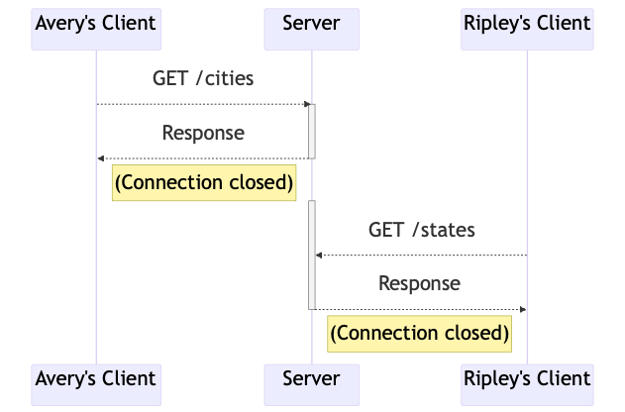
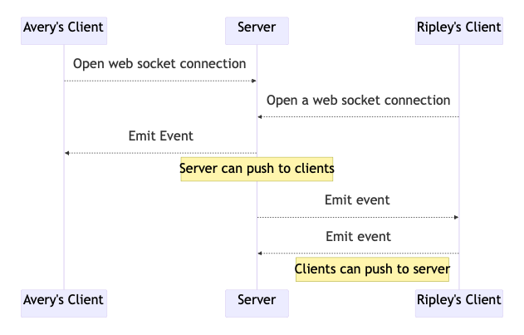
Push or Pull? We’ve Seen This Already (1)
HTTP (one-way, client initiates)
Web Sockets (two-way after client opens socket)
Notes:
These previous slides describe a very specific instance of producer/consumer, but at this point you all have experience with several concrete example of this patterns.
HTTP and WebSockets are large-scale examples of the push and pull pattern being used for communication between these systems: HTTP uses the pull pattern, and websockets allows for updates to be pushed to multiple clients.

Slide 22
Push or Pull? We’ve Seen This Already (2)
The clock and JavaScript event handling both use callbacks — a mini-pattern of their own — with the push pattern.
With `onClick`, the browser is the producer/server, your app is the consumer/client
<button
onClick={() => {
navigate(`/profile/${user.username}`)
}
>
View Profile
</button>
export class PushingClockClient {
private _time: number;
constructor(theClock: IPushingClock) {
this._time = theClock.currentTime();
theClock.addListener((time) => {
this._time = time;
});
}
get time(): number {
return this._time;
}
}
Notes:
When you create a button with an `onClick` handler, what is acting as the producer, and what is acting as the consumer?
(click to reveal)

Slide 23
Pattern #3: The Singleton Pattern
Maybe you only want one clock in your system.
You can't just say "new Clock" because that always creates a new object of class Clock.
Notes:
Let's get back to clocks for one last pattern: The Singleton Pattern.
<read slide>

Slide 24
Test-Driven Development
src/pullingclock/simpleClockUsingPull.test.ts
src/singletonClock/singletonClock.test.ts
test("clocks are independent", () => {
const clock1 = new SimpleClock();
const clock2 = new SimpleClock();
expect(clock1.currentTime()).toBe(0);
expect(clock2.currentTime()).toBe(0);
clock1.tick();
clock1.tick();
clock1.tick();
expect(clock1.currentTime()).toBe(3);
expect(clock2.currentTime()).toBe(0);
});
test("clocks are NOT independent", () => {
const clock1 = ???
const clock2 = ???
expect(clock1.currentTime()).toBe(0);
expect(clock2.currentTime()).toBe(0);
clock1.tick();
clock1.tick();
clock1.tick();
expect(clock1.currentTime()).toBe(3);
expect(clock2.currentTime()).toBe(3);
});
Notes:
How can we tell whether we have only one clock?
We can start with a test-driven development description of what we want: when we create two clocks, we want them to always be aliases of each other, so that ticks and resets of one clock affect the other clock.

Slide 25
One Singleton Pattern Implementation: First-time Through Switch
class PrivateClock implements IPullingClock {
private _time = 0;
reset() { this._time = 0; }
tick() { this._time++; }
currentTime() { return this._time; }
}
let privateClock: null | IPullingClock = null;
export function clockInstance(): IPullingClock {
if (!privateClock) {
privateClock = new PrivateClock();
}
return privateClock;
}
the "first-time through" switch is a mini-pattern itself!
Notes:
There are a lot of much more Java-Object looking ways of implementing this idea, but this is probably the most straightforward way of implementing this in JavaScript.
A JavaScript file is a module, and local information that isn’t exported from the module can’t be accessed outside the module.
Because the PrivateClock implementation isn’t exported, this file is the only file that is allowed to make a PrivateClock. Initially we don’t call the constructor (it’s usually, though not always, a bad idea to have code that runs immediately when a file is loaded in JavaScript).
The only way to access a PrivateClock is through the `clockInstance` method that is exported from the module, and so the first time the function is called, we’ll create a new clock and return it. Every future time we access the clock we’ll just return the one we already constructed.
That `clockInstance` function is what we’ll call in our tests to produce a clock.

Slide 26
Singleton Pattern We’ve Seen This Already
Each repository model (GameRepo, ChatRepo, etc) keeps track of a singleton Keyv object specific to that repository
The first time a repository method is accessed, a first-time-through switch initializes the key-value store
Notes:
Q: Are there other instances where you’ve seen the singleton pattern and/or your

Slide 27
Review: Learning Goals for this Lesson
You should now be able to:
Explain how patterns capture common solutions and tradeoffs for recurring problems.
Explain and give an example of each of the following:
The Demand-Pull pattern
The Data-Push (aka Listener or Observer) pattern
The Singleton pattern
Do the same for other mini-patterns
Dependency Injection
The Delegate or Callback pattern
The first-time-through switch
Notes:
<read slide>

Slide 28
Review: Learning Goals for this Lesson
You should now be able to:
Explain how patterns capture common solutions and tradeoffs for recurring problems.
Explain and give an example of each of the following:
The Demand-Pull pattern
The Data-Push (aka Listener or Observer) pattern
The Singleton pattern
Notes:
<read slide>

